Slide 1


Smart Travel Planning Platform
Presented by: Alchemist
Members: Om Dhuri(Group Leader)
Onkar Avhad
Soham Desai
Harsh Gaikwad

Slide 2
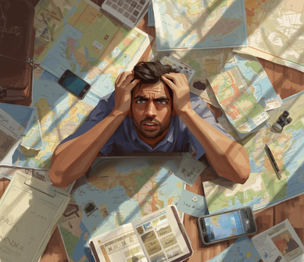


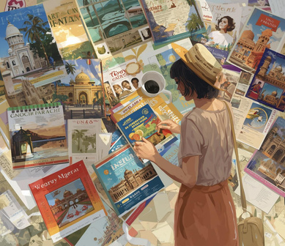

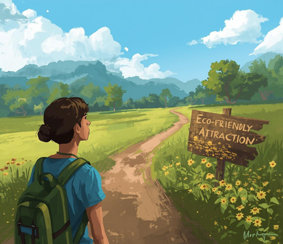
Key Pain Points in Travel Planning
Itinerary Issues
Budget Misalignment
Interest Filters
Time Management
Eco-Friendly Discoveries
Generic Apps
Lack of smart itinerary leads to inefficiency.
No fit between budget and destination causes issues.
Absence of filters limits personalized travel experiences.
Poor management leads to rushed and wasteful trips.
Limited local attractions reduce immersive experiences.
Commercialized apps promote paid options over authenticity.

Slide 3

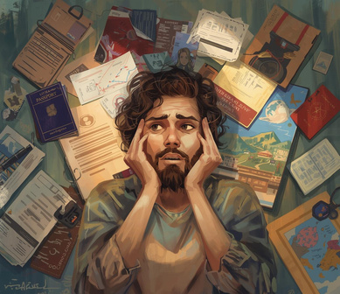

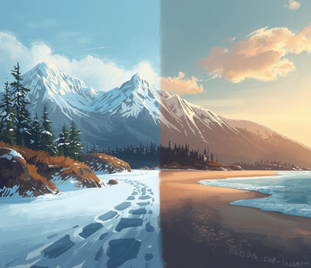


Key Pain Points in Travel Planning
Customization
Guidance
Local Culture
Seasonal Mismatches
App Confusion
Authentic Experiences
No tailored plans for different ages or groups.
Lack of clear information on regulations and permits.
Sustainable food options often overlooked by travelers.
Incompatibility between activities and traveler's time of visit.
Difficulty navigating through various conflicting travel apps.
Generic listings overshadowing real local attractions.

Slide 4
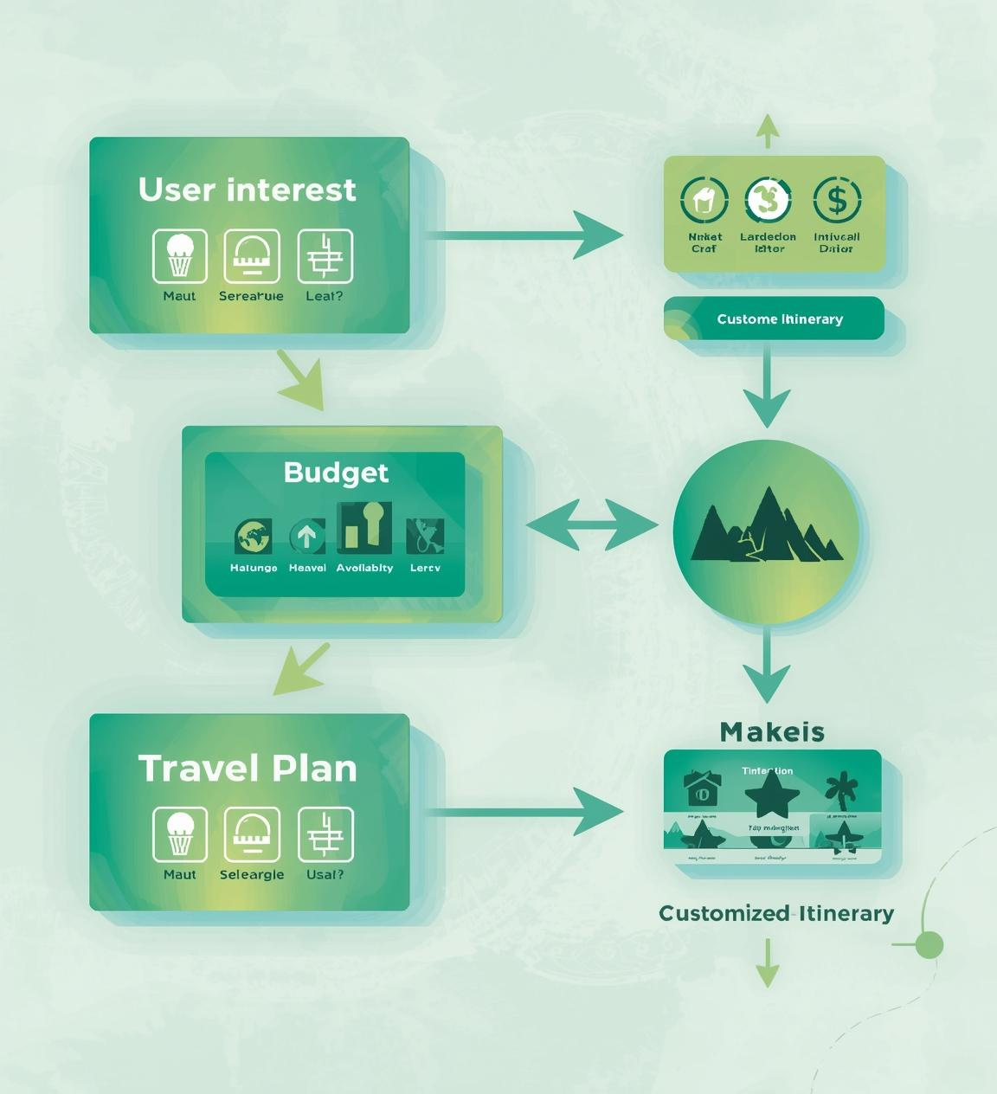
Platform Overview & Benefits
Personalized recommendations based on user travel preferences
Structured filtering options for interests and budget considerations
Automated itinerary generation for hassle-free travel planning

Slide 5
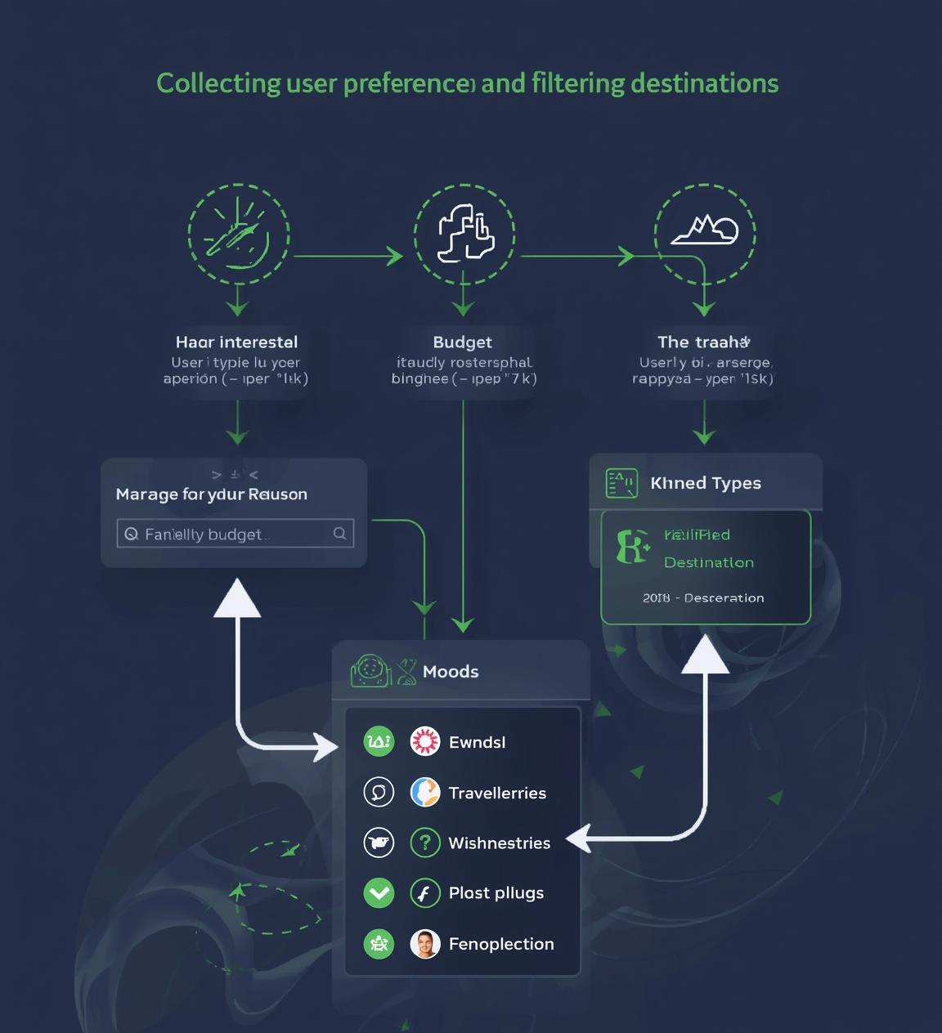
User Preferences and Filtering Logic
The platform gathers user preferences, including interests, budget, travel type, and mood. These inputs are processed through a structured filtering mechanism to generate tailored destination recommendations.

Slide 6


Day-wise Itinerary Overview
Day 1: Arrival
Day 2: Exploration
Day 3: Adventure
Day 4: Reflection
On the first day, travelers arrive at their destination, settle into accommodation, and enjoy a welcome dinner featuring local cuisine, providing an opportunity to relax and recharge.
The second day is dedicated to exploring major attractions, engaging in guided tours, and discovering hidden gems, encouraging participants to immerse themselves in the local culture and environment.
Adventurous activities await on day three, whether it's hiking, biking, or water sports, offering exhilarating experiences and unforgettable memories, all while surrounded by stunning natural landscapes.
The final day focuses on relaxation and reflection, allowing travelers to revisit favorite spots, enjoy leisure time on the beach, or shop for souvenirs before heading home.
Travel Collaboration
Effortless sharing and group planning tools

